Slide 1
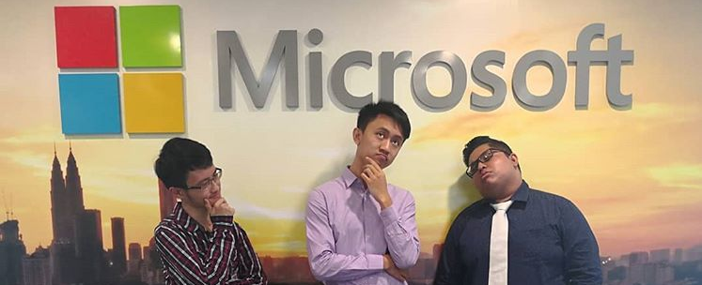
Artificial Intelligence Use Cases
University of Southampton Malaysia

Slide 2
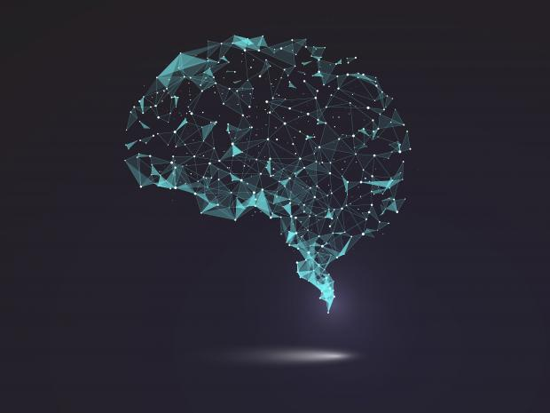
What is Ai?
Neural Network

Slide 3
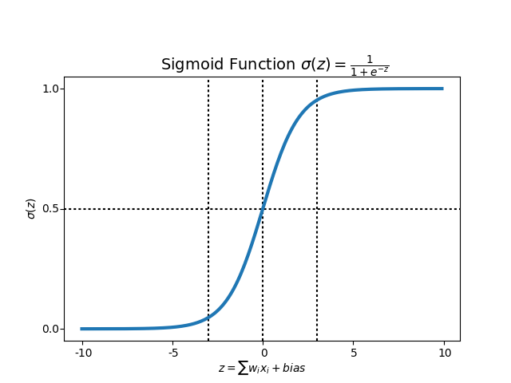
Sigmoid Curve?

Slide 4
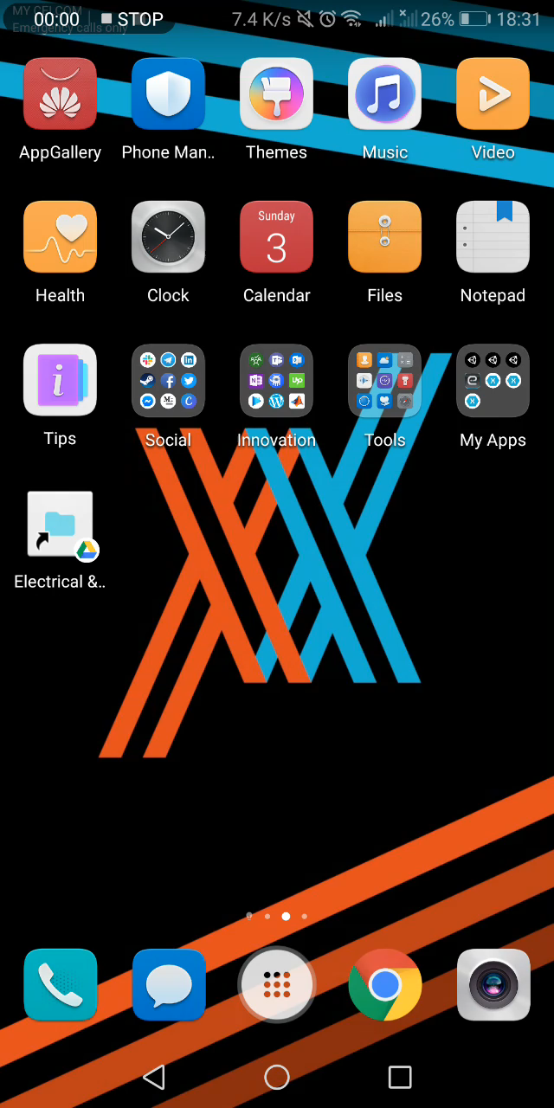
Weather
Forecast
LTSM, long short-term memory RCNN , reconvolutional neural network

Slide 5
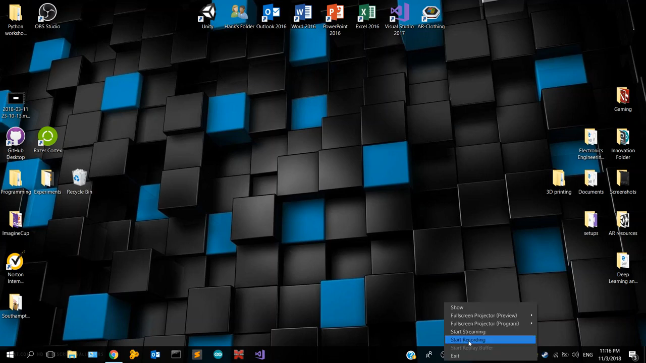
T-Shirt Size Prediction
Facial Recognition (Haar Cascade)
T-shirt size Classification (Tree-Classifier)

Slide 6


Recommendation Systems, fuzzy k-means

Slide 7

GANs, Generative Adversarial Network

Slide 8

Building your own Ai

Slide 9
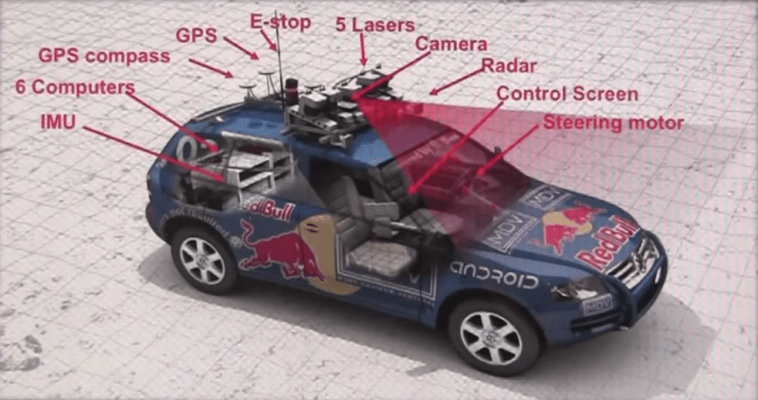
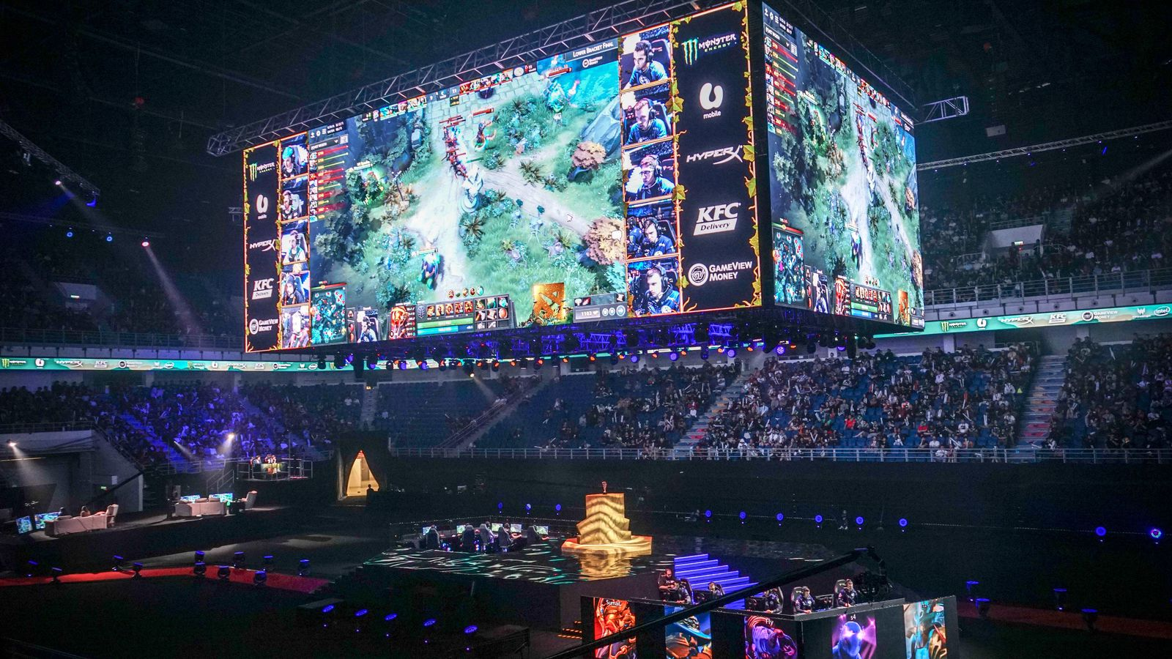
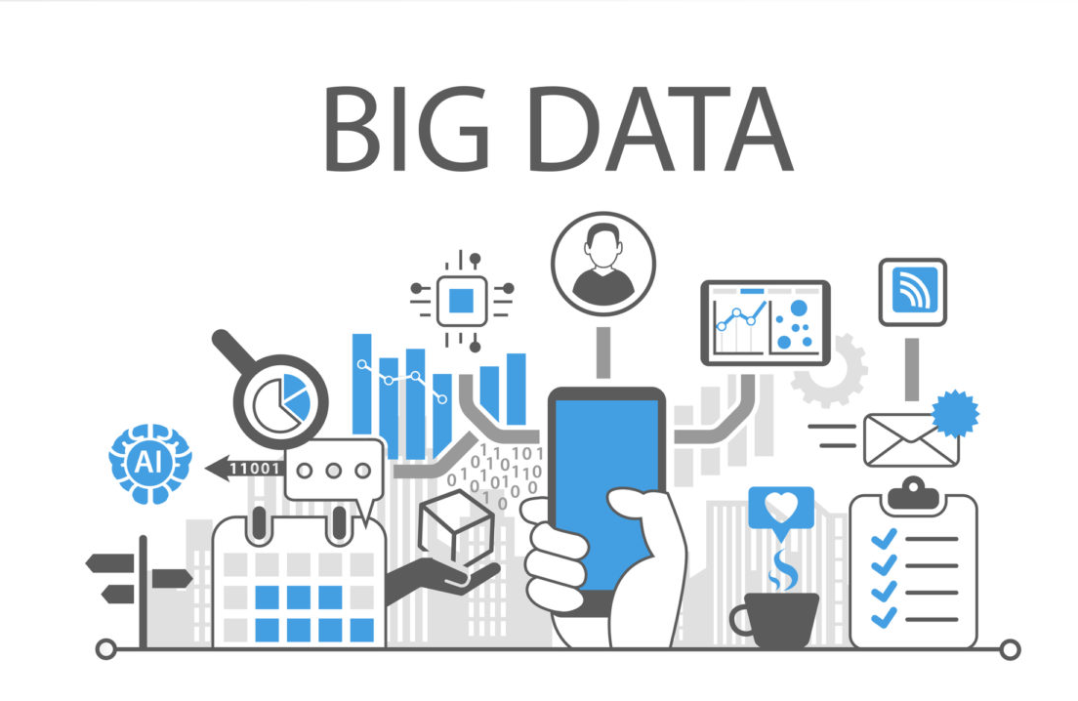
Future Impact on Industries?

Slide 10
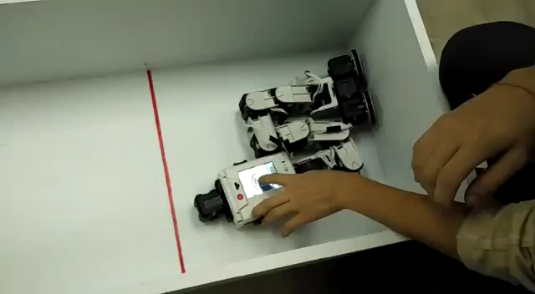
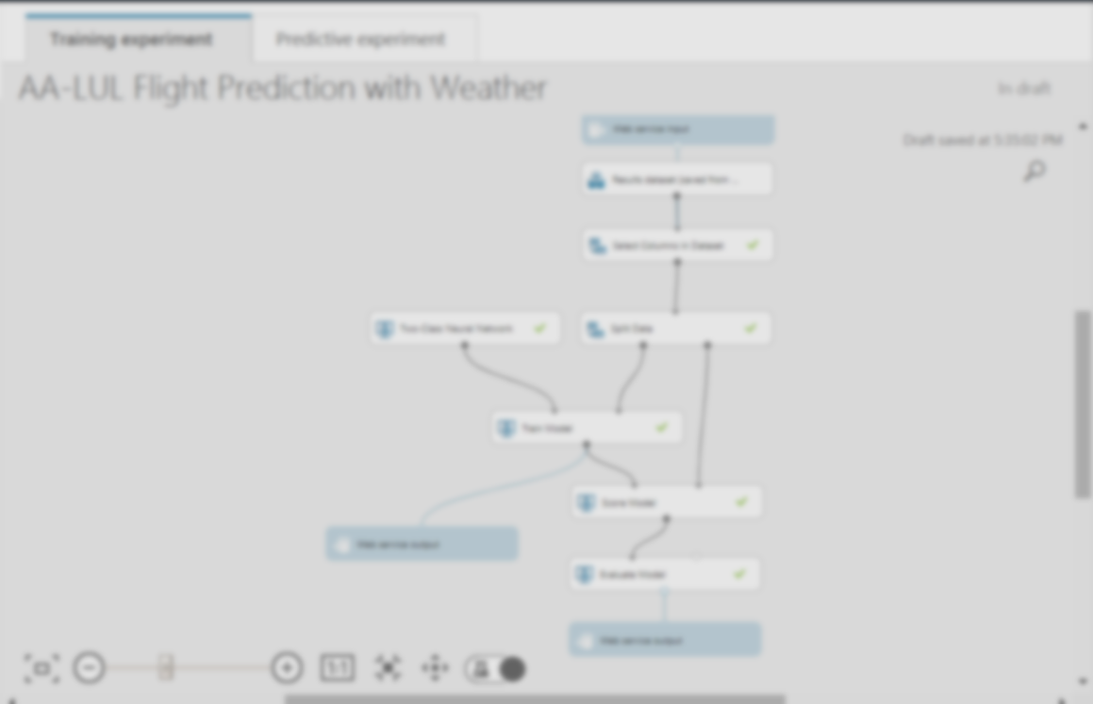
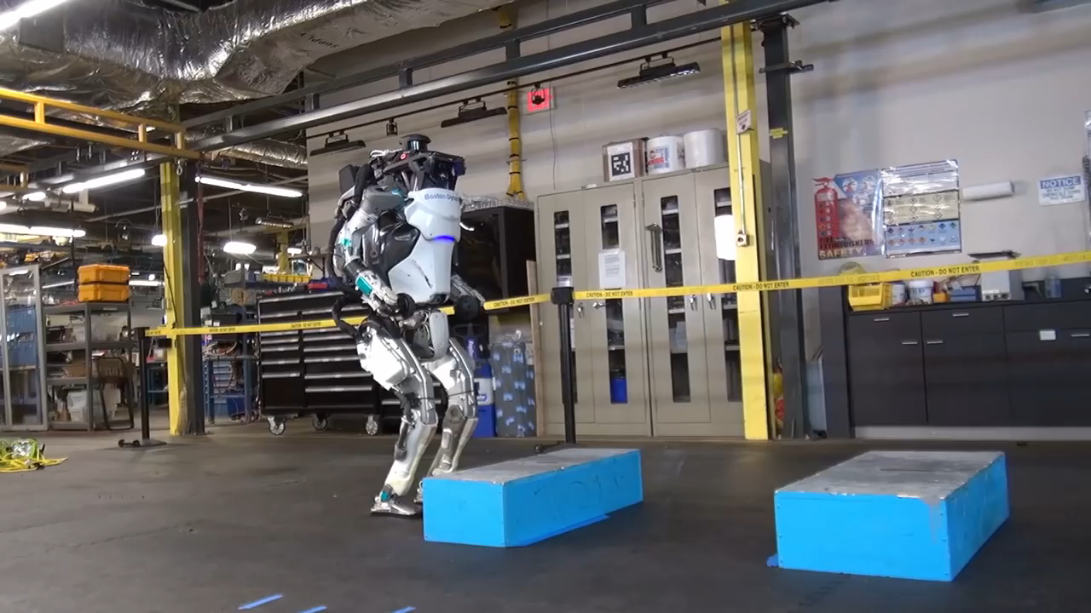
My special favourite use case: Robotics

Slide 11

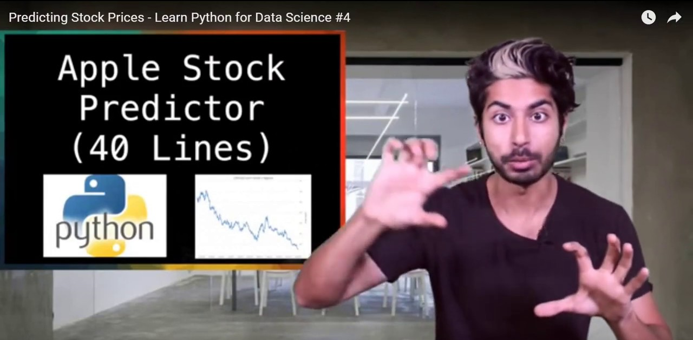
Self learning platforms

Slide 12
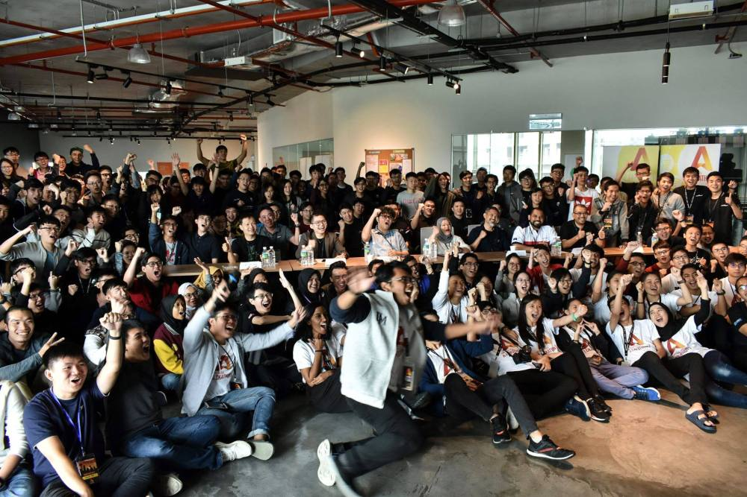
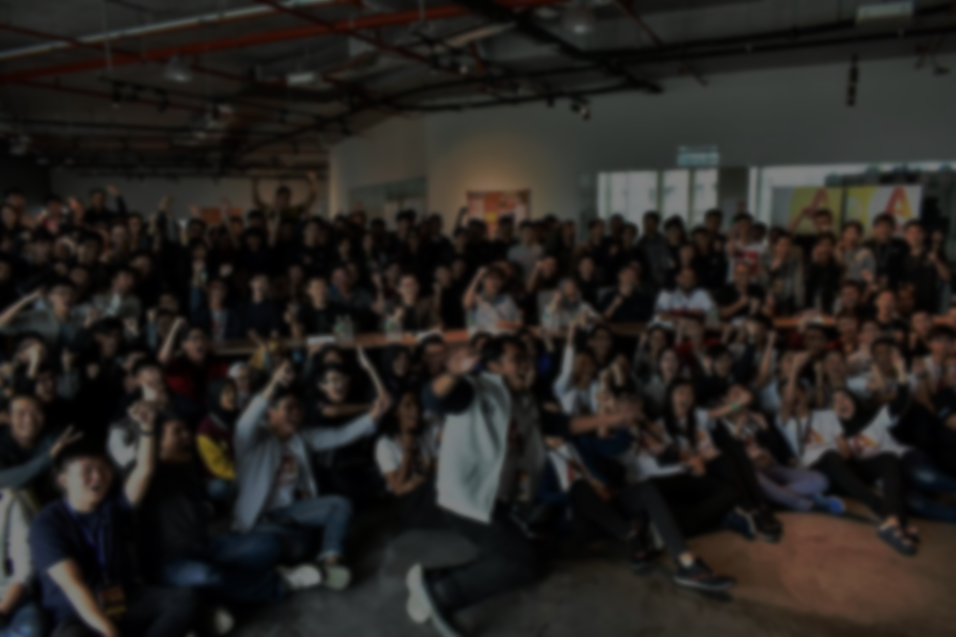
Hackathons

